Slide 1





Finance Forward Overview
Finance Forward Vision
Finance Forward Goals
Finance Forward is the creation of a unified financial environment that simplifies operations, safeguards resources, and fosters accountability across the University.
Make it easier to get work done right, the first time
Gain administrative efficiencies across the University
Proactively identify and mitigate financial risk

Slide 2
Key Projects
Finance Forward has identified and prioritized a portfolio of projects that will achieve the overall goals of the Program. Each project will be enabled by resources and capabilities to ensure success while helping build change resilience.
Current Projects Include:
School Compliance Dashboard
(Operational)
Procurement Transformation
Research Services/ PennERA
Payroll
Implemented in 2024, the dashboard provides greater visibility across the University’s compliance metrics.
The Procurement Transformation seeks to advance the overall procurement function to bring efficiencies into how the University sources, buys, and pays for products, services, travel, and other expenses.
Evaluation of options for upgrading Penn’s research lifecycle management system, focusing on the complete grant lifecycle, in partnership with the Sr. Vice Provost for Research.
The Payroll initiative seeks to reduce errors and improve accuracy through updated processes, technology enhancements, and improved monitoring and controls.

Slide 3



Completing the Picture
Building on the qualitative feedback and quantitative data points collected, the Higher Education Administrative Activity Study (HAAS) will provide input to both Central and Schools/Centers on:
Level of Effort
Distribution of Effort
Role Portfolio
How many people and hours does it take to complete specific administrative activities today?
How is administrative work distributed both within and across S/Cs and Central DoF? Where is there duplication?
What are the titles & roles that support these administrative activities? Are they generalists or specialists?

Slide 4
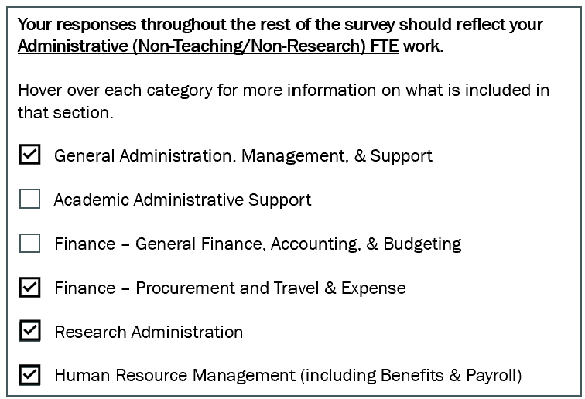
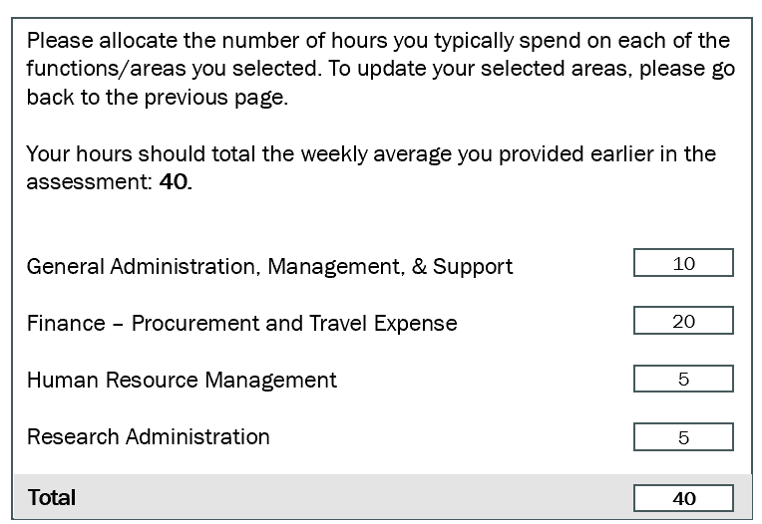
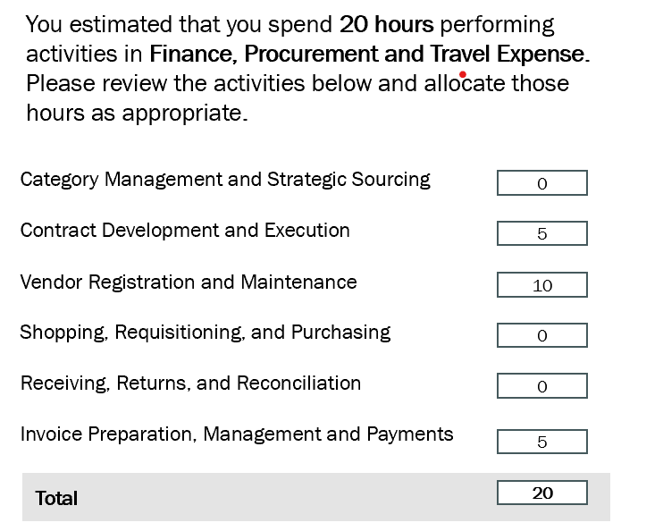
How Data is Captured with HAAS
HAAS data is generated by participants selecting the functions in which they work, how much time they spend on those functions, and how much time they spend on sub activities within each function.
Question 1. Participants select functional area(s) in which they work
Question 2. Participants allocate the hours in which they work in each functional area
Question 3. Participants allocate hours spent on sub-activities within a function

